Slide 1
Insurance Education and Career Training for Free
InVEST
Presented by Jennifer Robinson

Slide 2
What is InVEST?
InVEST is a 501(c)(3) non-profit educational trust dedicated to improving insurance literacy in students and attracting new talent to the industry.
Founded by the Independent Insurance Agents and Brokers of America (Big “I”)
Supported by over 100 insurance companies and other organizations

Slide 3
InVEST History
InVEST started in 1970 in Hollywood, Calif. to improve insurance knowledge of graduating high school seniors.
It has now developed into a career training and insurance literacy program to bring more young people into the insurance industry and help them become better insurance consumers.

Slide 4
Insurance Industry Needs Talent
60% of current insurance professional are over the age of 45 and looking to retire over the next 15 years.
Young people perceive the insurance industry as “old in general” (63%) and not innovative (53%.)
55% of young people would consider a career in insurance after learning more about the opportunities.

Slide 5
InVEST is Flexible
InVEST is comprised of three main sections:
InVEST Textbook
Mock Agency Preparation
Mock Agency Simulation
Schools can choose to teach InVEST for two weeks, or an entire year!
Notes:
Auto/home workbook – eight chapters, two can be stretched into two weeks.

Slide 6
InVEST Textbook
Introduction to Insurance
Managing Risk
Issues in Automobile Insurance
The Personal Auto Policy
Marketing and Selling Auto Insurance
Determining the Price of Auto Insurance
Insurance Agency Operations
A Career in Insurance
Property Insurance for Homeowners and Renters
Homeowners Liability Insurance
Life and Health
Businessowners Policy

Slide 7
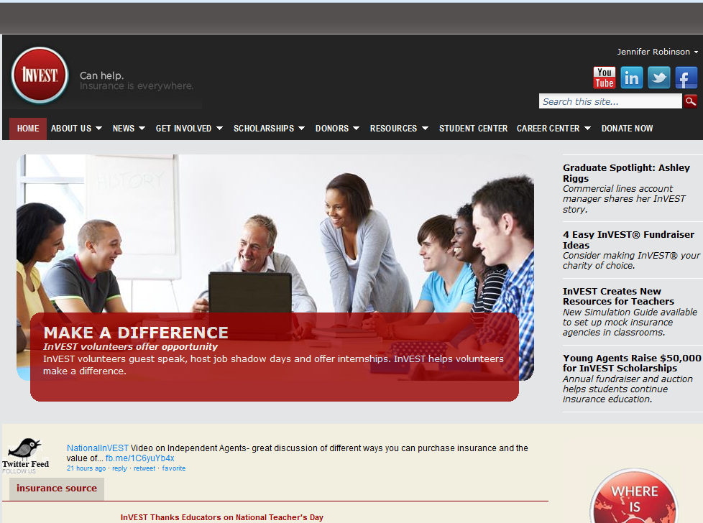
InVEST Website www.investprogram.org

Slide 8
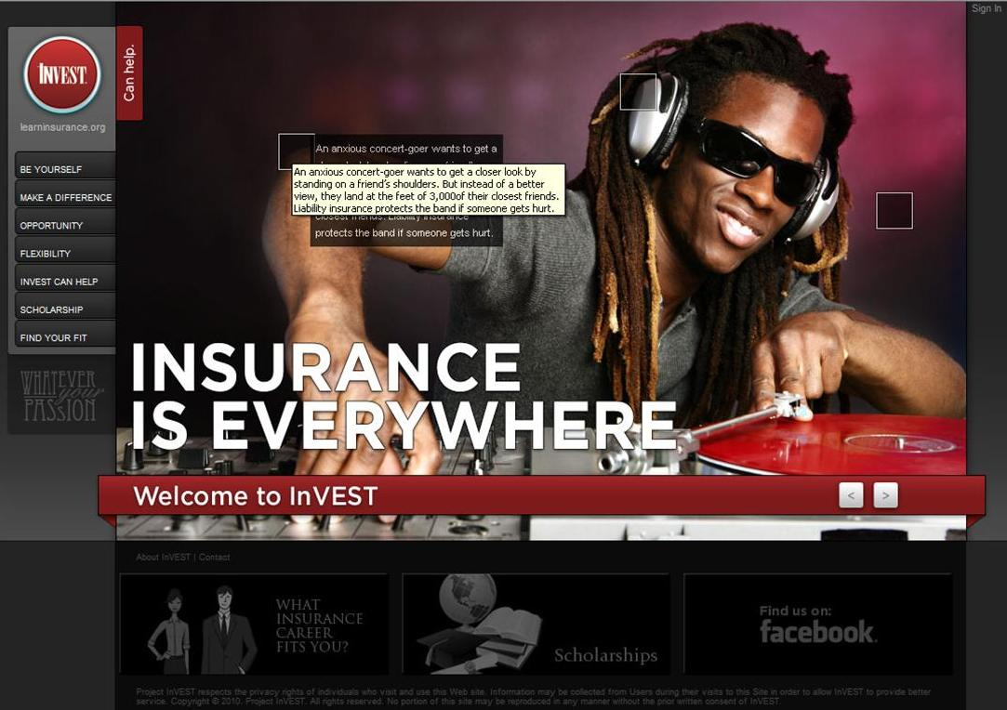
Student Website www.learninsurance.org

Slide 9
Creating an insurance environment
Have students apply for and interview for the set positions
Separate students into the home office and several different insurance agencies

Slide 10
Mock Agency Preparation
Students build an agency from the ground up, including:
Creating the name, logo, tag line, letterhead, etc.
Apply for a corporate loan and open a corporate bank account
Pay rent, electricity, etc.
Create marketing materials to sell their agency to prospects
Learn how to use ACORD forms, rating software and process auto insurance applications.
*Students do not actually start real agencies or sell insurance, they simply “act” like they are and go through the same motions.

Slide 11
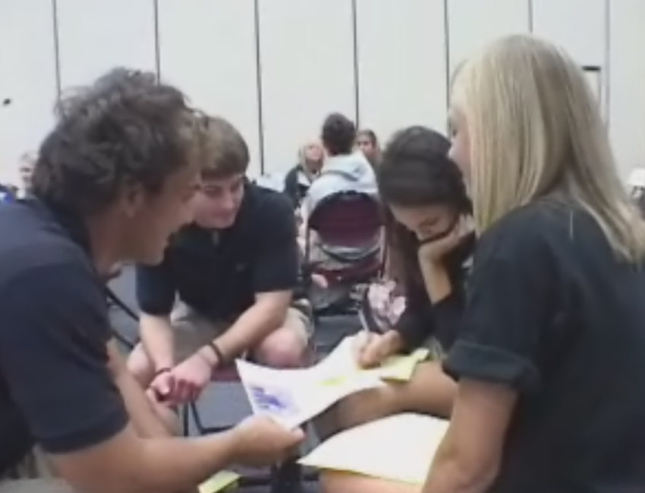
Mock Agency Simulation
Solicit new clients using marketing materials
Meet potential clients and fill out forms needed to approve an insurance policy
Use rating software to approve potential clients
Accept payment for the premium from the client
Process paperwork through home office underwriter, provide 85% of the payment from client to the home office.
Run reports each Friday to see sales results/income

Slide 12
Role of Local Insurance Professionals
Liaison
Guest speakers
Field trips/job shadows
Mock interviews
Internships

Slide 13
Scholarships
Over $600,000 in scholarships given to InVEST graduates
Classroom to Career and Higher Education
Mentor Program for Scholarship Winners

Slide 14
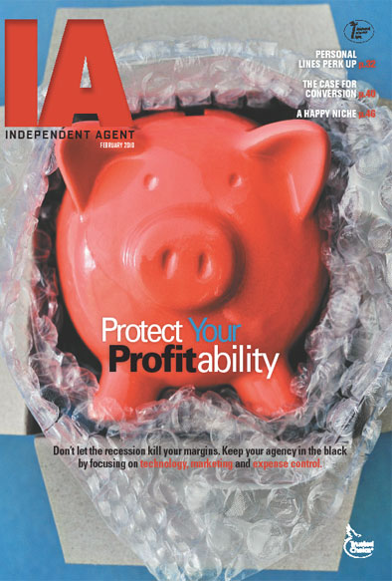
IA Magazine
InVEST teachers receive Big “I”s insurance magazine, IA Magazine, which provides current and valuable industry information and can be used in your classroom.

Slide 15
What Does it Cost?
Teacher Kit including Lesson Plans - $0
Workbooks - $0
Rating Software - $0
Guest Speakers - $0
Scholarship application -$0
Promotional Materials - $0
Certificates of Completion -$0
Costs you NOTHING!

Slide 16
www.facebook.com/NationalInVEST
For more information, contact national staff at 1-800-221-7917 or info@investprogram.org
Jennifer.robinson@iiaba.net
www.learninsurance.org
www.investprogram.org

