Slide 1

Collaboration Roundtable
Prepared for
ADVANCE CTE Conference
October 18, 2016
Notes:
Advisory Committee Questions
Take a minute to reflect on your own experiences as a member of an advisory committee. Please commit your thoughts to paper below:
1. Advisory Committee work
Assessment and counsel
-Its about program improvement.
Assistance
-securing mentors, WBL, long term planning
Promotion, advocacy, recruitment
-working with the community, legislators, professional organizations
Question: reflect on your own committee.
How have you provided the above components ?
2) Cycle of Work
Question: Reflecting on your own committee. how have your intersected with the Perkins cycle of work? How could that be improved?
3) Structure and Design
Questions:
What works well in your current committee?
What is a barrier to good work?
What would you like to add, delete, change?

Slide 2
Minnesota’s Federally-Approved
CTE Goals
Goal 1: Design & Implement Programs of Study
Goal 2: Effectively Utilize Employer, Community,
and Education Partnerships
Goal 3: Improve Service to Special Populations
Goal 4: Provide Continuum of Service Provisions
for Enabling Student Transitions
Goal 5: Sustain the Consortium of Secondary and Postsecondary Institutions
www.cte.mnscu.edu/aboutus/mission/index.html
2
Notes:
Impending reauthorization give opportunity for MN to update our State Plan.
The Minnesota CTE Goals were approved and are reviewed every year in the state plan review process by the US Department of Education, Office of Career Technical and Adult Education (OCTAE). They include rigorous programs of study within career pathways, partnerships, ensuring success of all students (including special populations), student transitions-high school to college, among consortia and to further education, and sustaining the consortium.
ABE can partner with consortia on all of the goals, especially 2, 3 and 4
In the Perkins legislation, the term “special populations” means
individuals with disabilities;
individuals from economically disadvantaged families, including foster children;
individual s preparing for nontraditional training and employment;
single parents, including single pregnant women;
displaced homemakers; and,
individuals with limited English proficiency.

Slide 3
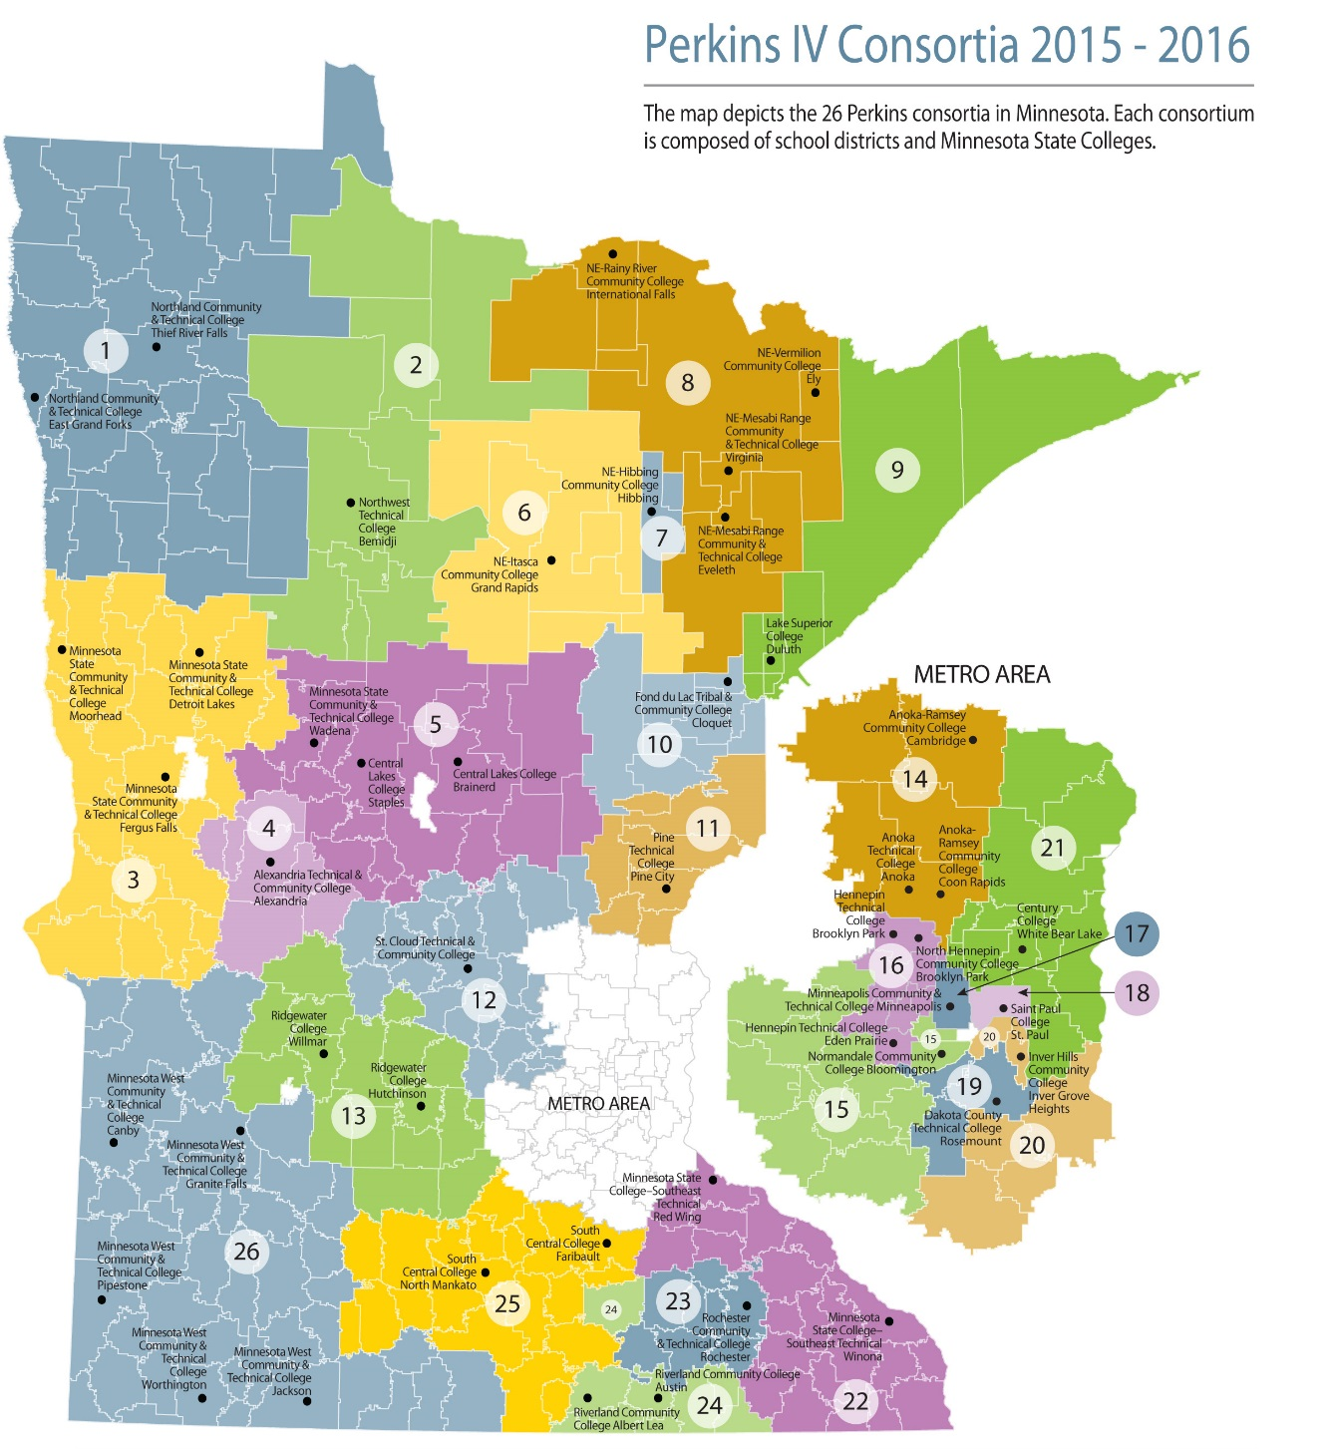

26 Consortia
Minneapolis
1 college + 1 district
7 high schools
St. Paul
1 college + 1 district
8 high schools
Minnesota West
1 college (5 campuses) + 43 districts
Notes:
Let me do a quick overview of how Perkins work is organized in the state of Minnesota.
Here’s an overview of geographic lay-out of the State’s 26 Perkins consortia.
Each consortium has a minimum of one college and one school district.
We do have one consortium with 40 school districts- I think that’s the max.
You can see the organization is geographical. Joining our 343 high schools with
You have 2 handouts that speak to the students we serve, the increased success of our distinct population when CTE is part of their education, and the profile of our diverse students.
Metro “call Out’ map #17 and #18 represent our consortia with One College + One District
Minnesota West represent the multiple campuses and multiple districts– 5 campuses/one accredited college and 43 districts
PLAY THE SLIDE TO SEE IT
Funds distributed to 26 consortia that include:
at least one secondary district
at least one eligible
postsecondary institution
Each consortium submits a single unified local plan developed to benefit the consortium as a whole.
CLICK
Minneapolis and St Paul are only consortia with one school district -- # of students??
Which consortium has the most students?
Which consortium is the smallest?

Slide 4
Work Flow
July 1 Allocation Award/Plan Approval
Oct. 15 Local APR Due
Nov. CTE Works Conference
Dec 31 State CAR DUE
Feb. Reallocation Award
June Local Plan Presentation
April State Plan Due
Jan. Negotiate Performance Targets
May Local Plan Due
Moni-toring Visits
Notes:
While a minimum of two meetings/year is requested, the most viable committees are part of all the major components of the Perkins work plan. Sometime after the first of the year, the consortium will performance indicator targets. That’s an opportunity to review what that needs to be done. Its also a good time to begin the work on what could be…. What’s our dream for the program? What are our long term goals.
Short term operational components are taken care of by staff. What’s the long term outlook, goal, plan?
Question: reflecting on your own committee: how have your intersected with the Perkins cycle of work? How could that be improved?

Slide 5
Secondary- Postsecondary Collaboration
Requirement for the establishment of Programs of Study
Assessing CTE skills
  Academic (Liberal Arts & Sciences) skills
  Technical skills
  Workplace skills
Completion Agenda
Early Middle College Initiatives
Joint Advisory Committees

Slide 6
Thank You
Jeralyn Jargo
State Director of Career
& Technical Education
jeralyn.jargo@so.mnscu.edu
(651) 201-1650
wwww.cte.mnscu.edu
Look forward to seeing you at the 2016 CTE Works! Summit |
www.cteworksminnesota.org

